Slide 1
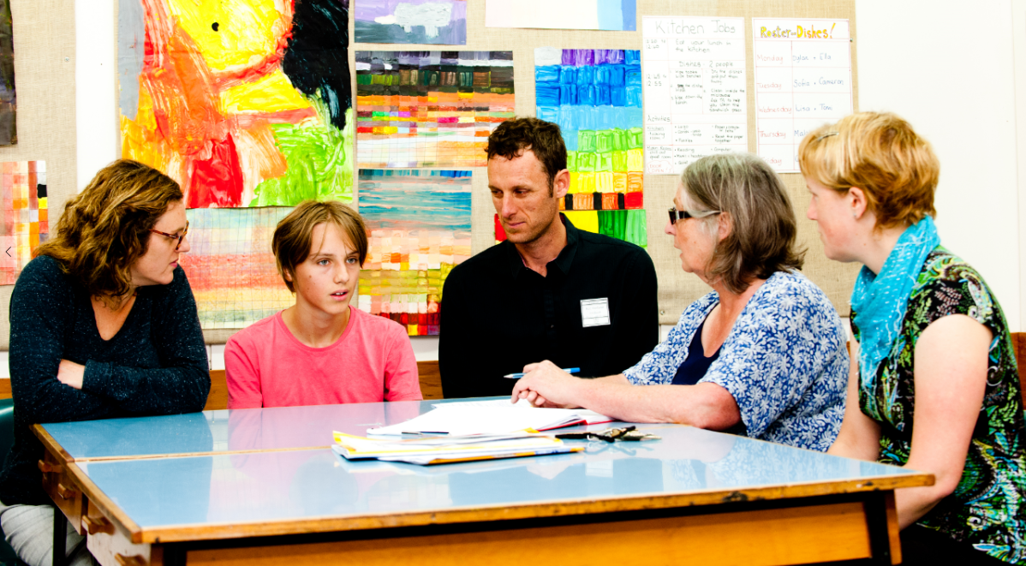
Teachers and Teacher Aides Working Together
Students Participating in their Individual Education Plans (IEP)
Module 6 Presentation

Slide 2
Introducing the module
This module is about students having a say in their learning.
It is for both teachers and teacher aides.
Please take your time to think and reflect.

Slide 3
Why this module?
Participating in the IEP process is one way that students can participate in their learning. It lets students express their strengths and wishes.
Teachers and teacher aides need to actively involve students in the process, and give them the support they need to participate.

Slide 4
What is an IEP?
An IEP shows how the school programme is adapted.
It’s not a different programme to the class.
It’s a plan for including the student within the curriculum.

Slide 5
IEP goals
The IEP sets goals that the whole team agrees are a priority.
Goals build on the student’s strengths and work towards what the student wants to do in the future.

Slide 6
Who does what in the IEP process?
Collaborative decision making is central to the IEP process.
Specific roles need to be clarified and agreed.
Parents have special knowledge about their child.
Teachers are responsible for all their students’ learning.
The teacher aide works to support the teacher.
What roles do teachers, teacher aides, families, whānau and students play in the IEP process at your school?

Slide 7
Give students a say in their learning
Effective teachers involve students in decisions about their learning.
Participating in their IEP gives students a say in their learning. It can build motivation, confidence and independence.

Slide 8
Students participating in their IEP
Means different things for different students:
taking part in conversations and meetings
using assistive technology
writing or recording ideas
family, whānau and peers providing information.
In what ways do students participate in the IEP process at your school? What ideas do you have for increasing their participation?

Slide 9
Students participating in their IEP
It’s not just about what happens at IEP meetings.
Students need access to their IEPs in a format that works for them:
written in the everyday language of the student
represented visually using pictures or symbols
as an audio recording
accessed on a device.
Do you think students at your school feel like they own their IEPs? How could you share their IEPs with them to build ownership?

Slide 10
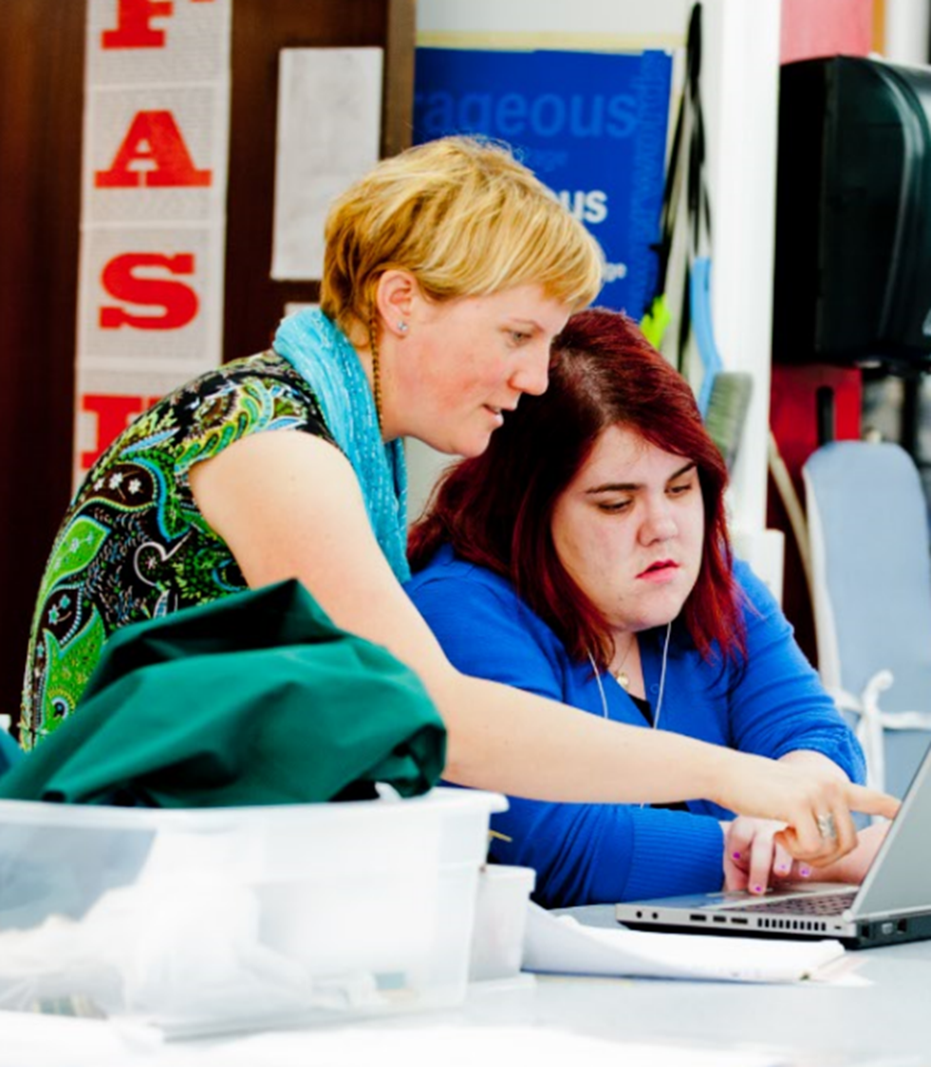
Students who don’t have an IEP
If a student doesn’t need an IEP, they still need to be involved in decision making.

Slide 11
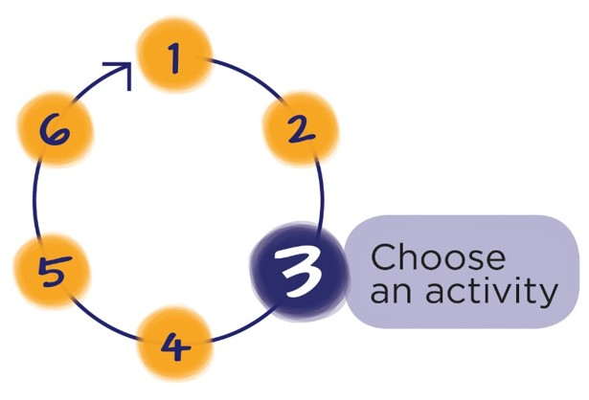
Download the workbook for this module at:
teachersandteacheraides.tki.org.nz/Our-students/Module-6
To find out more about Teachers and Teacher Aides Working Together and to access the other modules go to:
teachersandteacheraides.tki.org.nz
We wish you well in your learning!
Ngā mihi!
It’s time to choose an activity from the workbook for this module.

